Slide 1
TIME & TERRITOR MANAGEMENT
UNIT-7

Slide 2
WHAT IS SALES
TERRITORY?
◆ A sales territory consists of existing and potential customers, assigned to a salesperson.
◆ Most companies allot salespeople to geographic territories, consisting of current & prospective customers.

Slide 3
REASON FOR SETTING OR REVIEWING SALES TERRITORIES
◆ Increase market or customer coverage.
◆ Control selling expenses
◆ Better evaluation of sales force performance
◆ Improve customer relations
◆ Increase sales force effectiveness
◆ Improve co-ordination
◆ Benefit salespeople and company

Slide 4
REASON FOR NOT
SETTING-UP SALES
TE
RSmRall cIoTmpOanyRwiIthEonSe or few salesperson(s).
◆ Personal contacts or relationships is the basis of
making the sales.
◆ Sales persons get demotivated due to restrictions of sales territory.
◆ Management of the company may not be aware.

Slide 5
PROCEDURE FOR DESIGNING SALES TERRITORIES
Use build method
Select a
control unit
Find location and potential customer
Decide basic territories
OR
Use breakdown method

Slide 6
CONTROL UNIT
◆ States
◆ Metros
◆ Cities
◆ Districts
◆ Towns
◆ Pin Code Areas
◆ Industrial Estates
◆ Major Customers
Why sales manager should select smallest control unit?
The control units’ market
potential and the company
sales potential should be
possible to calculate.
Addition control possible territory modified territories.
and
units
when
deletion of
should be
tentative
boundaries
are to make final

Slide 7
FIND LOCATION AND POTENTIAL CUSTOMER
◆ Identification of the buyers as precisely as possible.
◆ Present & potential buyers indicate Market Potential.
◆ Determination of Sales Potential i.e. unit’s market potential that the company has an opportunity to obtain.
◆ Market potential is converted to sales potential by analyzing the historical market share , adjusting for changes in company & competitor selling strategies.

Slide 8
DECIDE BASIC TERRITORIES
◆ Build-up Method – The objective is to equalise the work load of sales person.
◆ Breakdown Method – The objective is to equalise sales potential of territories.

Slide 9
◆ Procedures followed in Build-up Method:
Step 1
Step 2
Step 3
Step 4
Step 5
Decide call frequencies
Calculate total number of calls in each control unit
Estimate workload capacity of a Salesperson
Make tentative territories
Develop final territories
◆ Procedures followed in Breakdown Method:
Step 1
Step 2
Step 3
Step 4
Step 5
Estimate company sales potential for total market
Forecast sales potential for each control unit
Estimate sales volume expected from each salesperson
Make tentative sales territories
Develop final territories

Slide 10
ASSIGNING SALESPEOPLE TO TERRITORIES
The sales manager should consider two criteria:
Relative ability of salespeople
◆ Based on key evaluation factors:
Product knowledge (4) communication
market knowledge (5) selling skills
past sales performance
(B) Salesperson’s Effectiveness in a Territory
◆ Decided by comparing social, cultural, and physical characteristics of the salesperson with those of the territory.

Slide 11
MANAGING TERRITORY COVERAGE
◆ It means “How salesperson
should
cover the assigned sales territory”.
◆ It includes three tasks for a sales manager:
Planning efficient routes for salespeople.(Routing)
Scheduling salespeople’s time.(Scheduling)
Using time-management tools.(Time Management)

Slide 12
ROUTING
◆ Routing is a travel plan or pattern used by a salesperson for making customer calls in a territory.
◆ The main advantage of routing are:
Reduction in travel time and cost
Improvement in territory coverage

Slide 13
◆ Identify current and prospective customers on a territory
◆ Procedures for setting up a routing plan:
map
◆ Classify each customer into high, medium, or low sales
potential
◆ Decide call frequency for each class of customers
◆ Build route plan around locations of high potential customers
◆ Computerized mathematical models are developed as follows:

Slide 14
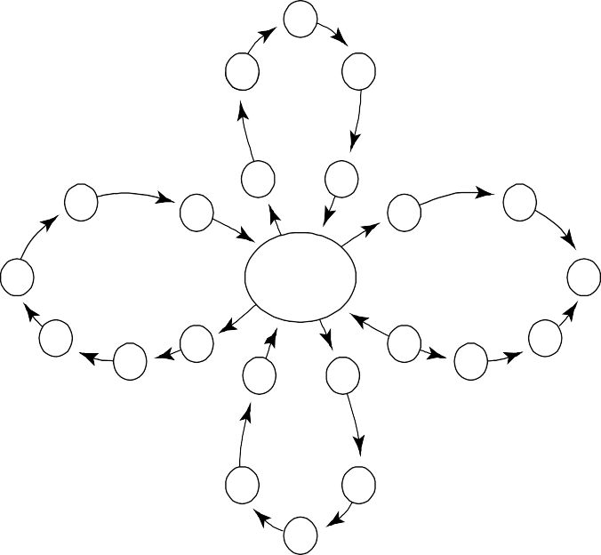
◆ Commonly used routing patterns are:
Cloverleaf Pattern
c
c
c
c
c
c
c
c
c
c
Base
c
c
c
c
c
c
c
c
c
c c
c
Each Leaf Out and Back Same Day

Slide 15
◆ Application and Importance of Routing: The degree of importance to the application of routing depends on two factors:
Nature of the product
The type of job of salespeople

Slide 16
SCHEDULING
◆ Scheduling is planning a salesperson’s specific time of visits to customers. It deals with time allocation problem.
◆ How to allocate salesperson’s time?
Sales manager communicates
to salesperson major activities and time
allocation for each activity
Salesperson records actual time spent on various activities for 2 weeks
Sales manager and salesperson discuss
and decide how to increase time.
◆ Companies specify call norms for current

Slide 17
TIME MANAGEMENT TOOLS
◆ It help salespeople to manage their time more efficiently and productively.
◆ Tools available are:
◆ High-tech Equipment
◆ Inside Salespeople
Sales assistance to provide clerical support for the outside salespersons.
Technical support people to give technical information and answers to customer’s questions.
Telemarketing to find new leads or prospects, qualify them and refer them to outside sales persons for high and medium sales potential prospects or sell for low potential customers.

